Slide 1



Slide 2


Slide 3


Slide 4
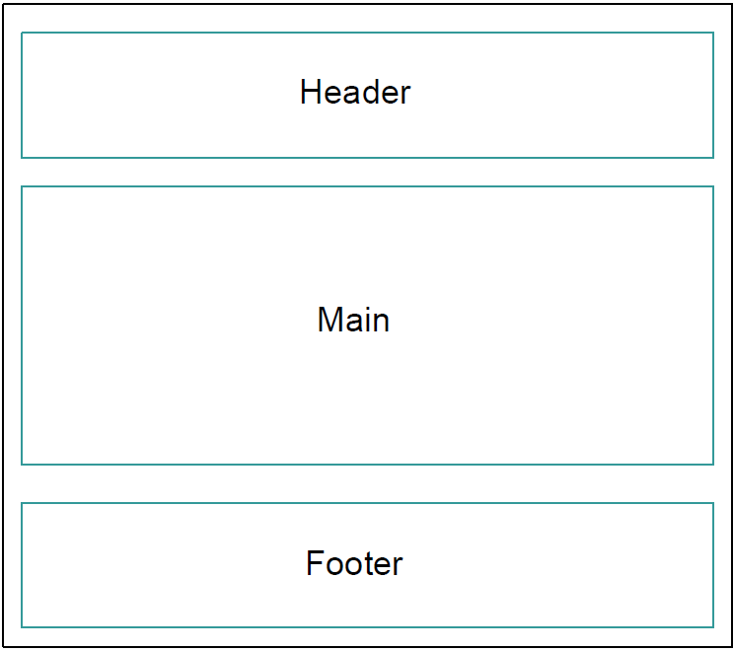
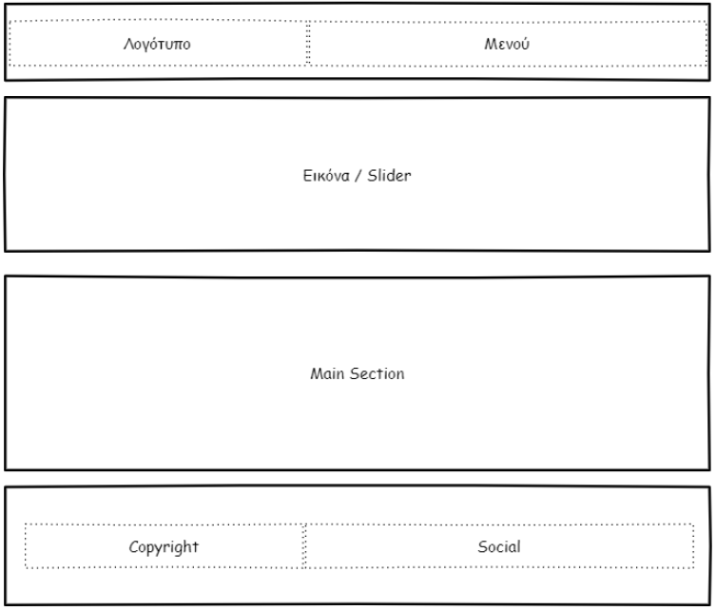

Slide 5
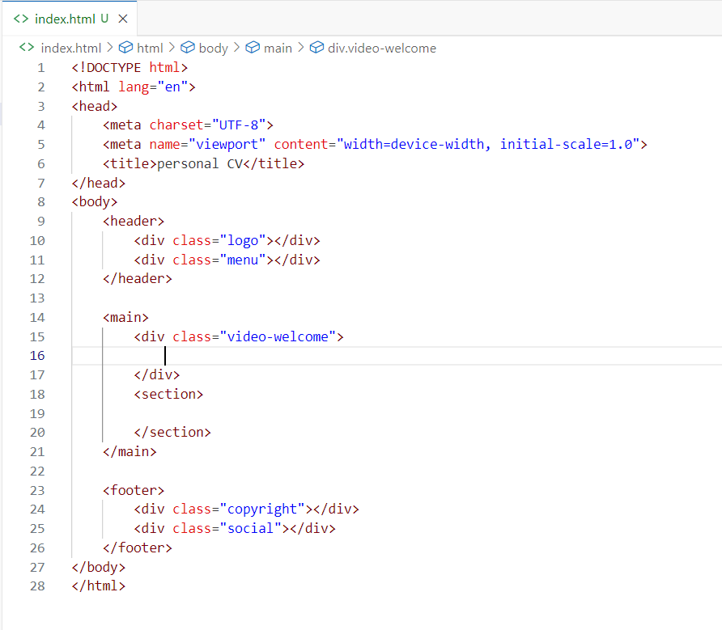

Slide 6

Ioannis
Antoniou

Slide 7
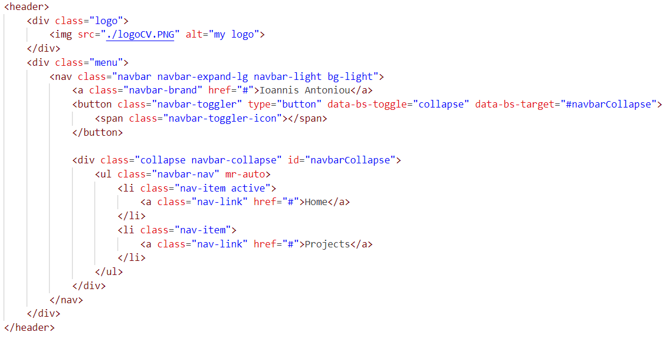

Slide 8
